Slide 1
CSV as Data Source Configuration
Presented By: Sopan Tambekar

Slide 2
CONTENT
Requirement of CSV As Data Source
Pre-Requisites
Configuration steps
Live Hands on
Q&A’s

Slide 3
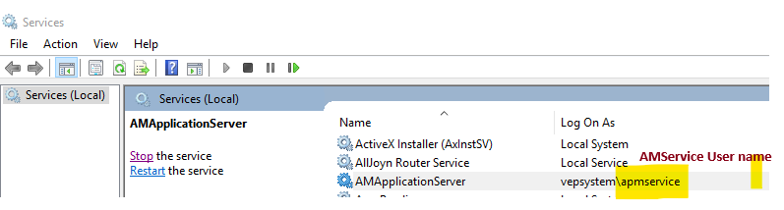
Requirement of CSV As Data Source
Testing –
POC –
Project –
Pre-Requisites
CSV file in proper format
Machine Setup details – Single Box or Multi-Box
AMService Username
Database Access

Slide 4

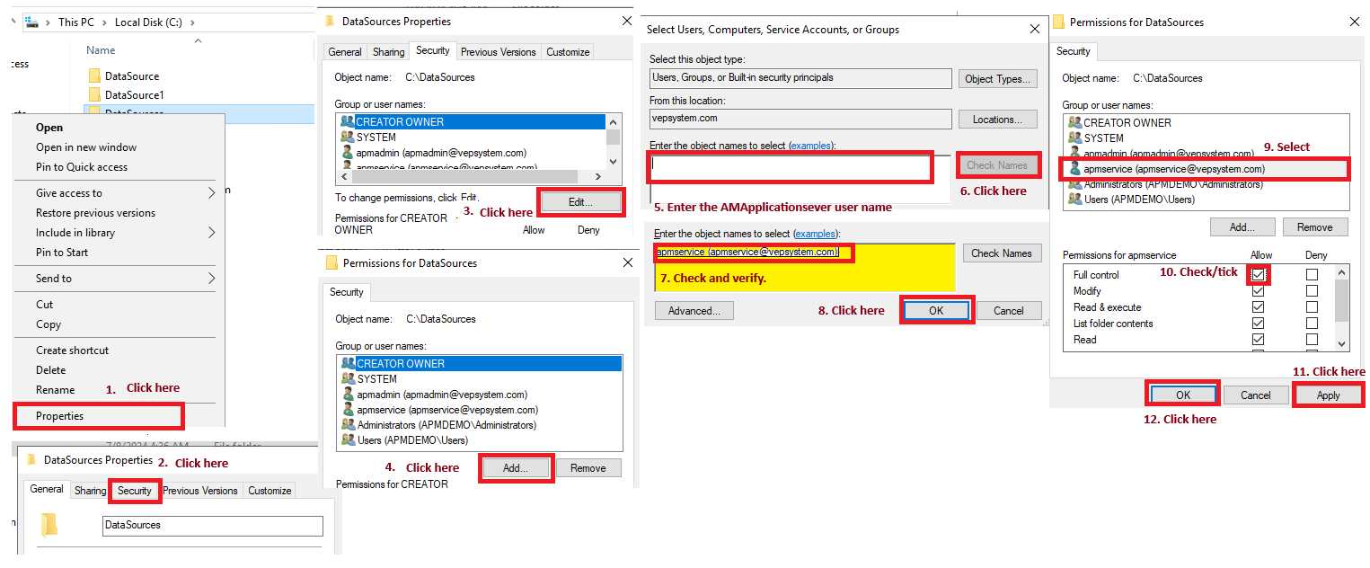
Configuration steps
Create a folder and keep the CSV file.
Give full control of the folder to AMService use. (In multibox – create same folder and give full control in all servers.) Right Click on Folder name and follow below steps. (In multibox- repeat all steps in all boxes).

Slide 5
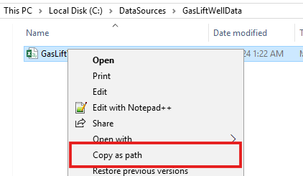
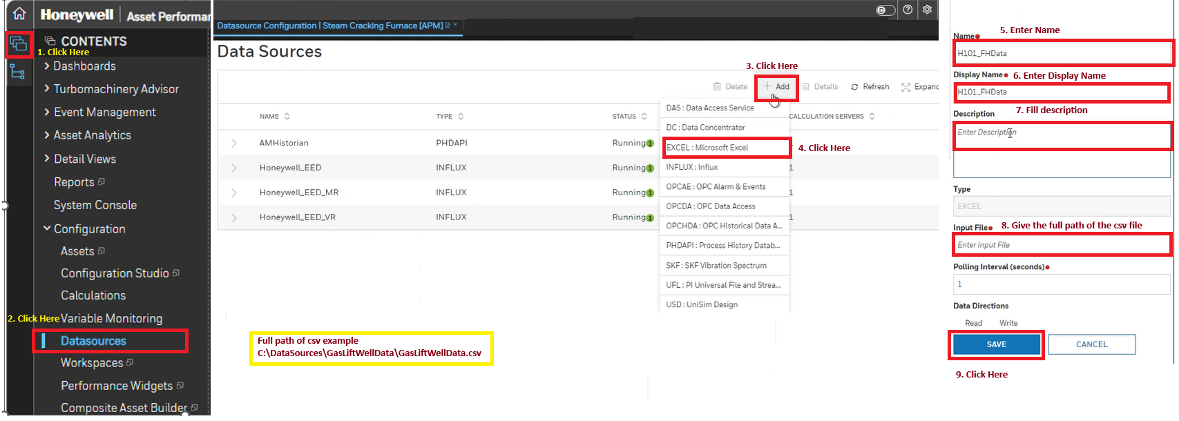
Configuration steps
Copy the path of the CSV.
Go to Datasource configuration page from Sentinel Content page.
Click on “+” on data source configuration page and select “EXCEL” form the menu.
Fill the details in respective boxes, like Name, DisplayName and description and path etc. And click on save.

Slide 6
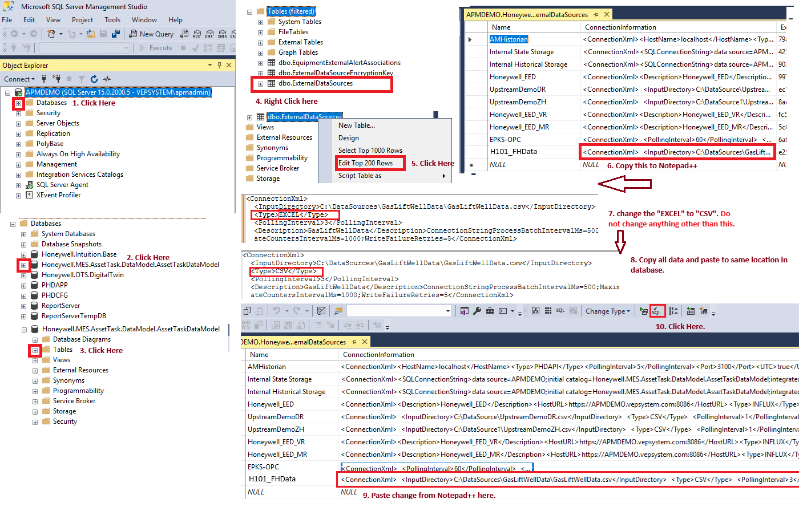
Configuration steps
Now go to data base and open the external data sources table.
Change from <type>Excel</type> to <type>CSV</type> connection information for the data source created. This is done with query or direct copy the content change the type and paste it back to same location.

Slide 7
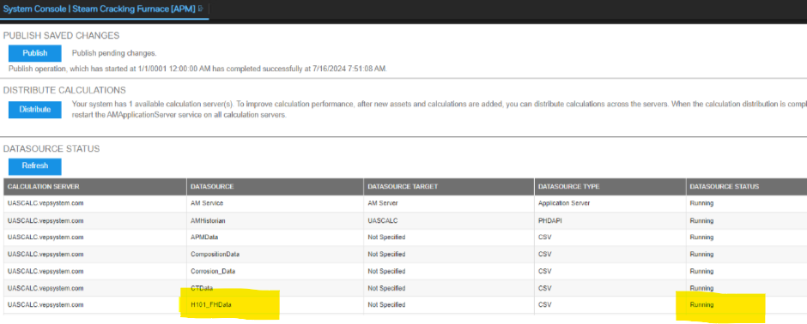
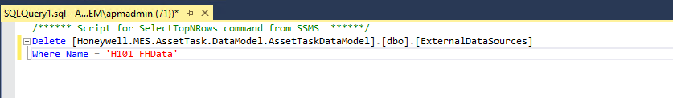
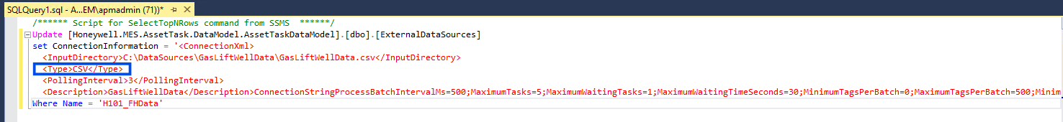
Configuration steps
Take AMservice restart.
Check on console page if CSV data source is running or not.
CSV data source can only be deleted from database. Write delete query.
Delete Query
Please do not miss the “Where condition” in this query. Otherwise, it will delete whole table.
Update Query

Slide 8


Live Hands on

